Slide 1

DAYANANDA SAGAR COLLEGE OF ENGINEERING
AN AUTONOMOUS INSTITUTE AFFILIATED TO VTU, APPROVED BY AICTE & UGC, ACCREDITED BY NAAC WITH 'A' GRADE.
AUTOMOBILE ENGINEERING, BIOTECHNOLOGY, COMPUTER SCIENCE & ENGINEERING, ELECTRICAL & ELECTRONICS ENGINEERING, ELECTRONICS & INSTRUMENTATION ENGINEERING, ELECTRONICS & TELECOMMUNICATION ENGINEERING, INDUSTRIAL ENGINEERING & MANAGEMENT, MEDICAL ELECTRONICS AND MECHANICAL ENGINEERING ACCREDITED BY NBA
DEPARTMENT OF MEDICAL ELECTRONICS
Project title: CardioHealth
Project Guide: Prof. Sahana M Kulkarni
STUDENT NAME | USN
DEEKSHA V | 1DS15ML006
FIHA AFRA | 1DS15ML009
PRATHIBHA K P | 1DS15ML023
SYED FIZA | 1DS15ML032

Slide 2

CardioHealth
Home Based Rehabilitation System for People with Cardiovascular Diseases
Notes:
fiha

Slide 3
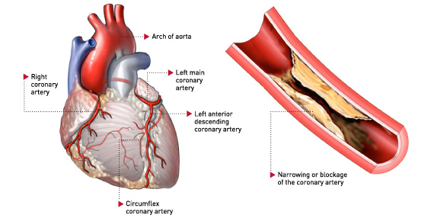
Cardiovascular Diseases
Coronary Artery Disease (CAD)
Heart attack
Heart failure
Angioplasty
Heart surgery
They can be managed in 2 ways:
Conservative Method
Surgical Management
Anyone under conservative or surgical method both are eligible for cardiac rehabilitation.

Slide 4
Cardiac Rehabilitation
Exercise is actually a key part of managing cardiovascular disease
Cardiac rehabilitation is a medically supervised program that involves exercise and other components to help improve heart health after a person had surgery, or suffers a heart attack or other significant cardiac event
Cardiac rehabilitation programs generally span three months, with sessions two or three times a week (usually 36 sessions over a 12-week time-period)
Notes:
Fiha and Fiza Cardiac rehab - 4 phases
Phase 1 - Early rehab. Upto 10 days restricted to hospital stay.
Phase 2 - Monitored rehab. 10 days to 3 months. Under the physiotherapist.
Phase 3 - Not monitored. 3 months to 1 year.Visit once a month for assessment and advice.
Phase 4 - Lifelong management. To avoid reversibility.

Slide 5
Phases of cardiac rehab
Cardiac rehab - 4 phases
Phase 1 - Early rehab. Upto 10 days restricted to hospital stay.
Phase 2 - Monitored rehab. 10 days to 3 months. Under the physiotherapist.
Phase 3 - Not monitored. 3 months to 1 year.Visit once a month for assessment and advice.
Phase 4 - Lifelong management. To avoid reversibility.
Cardiac parameter - heart rate (pulse rate calculated from heart rate)
Individually tailored exercise - MIDF
Mode
Intensity
Duration
Frequency
As consulted by cardiologist and physiotherapist

Slide 6
Affordability/ Current facilities
Rehab facilities - Focused in A grade hospitals
Inconvenience to travel to the specific centers
Targeted for upper class / Business oriented
Monitoring multiple patients/slots
The Problem
Frequent visits are required
Time consuming
Expensive
Difficulty in communicating with the practitioner about the progress
Lose motivation
Skipped sessions
Notes:
Fiza Time allotted per person

Slide 7
Solution
Home based system allows patient doctor interaction.
Concerns about home based system
Which set of exercises to perform
Number of repetitions per session
Not sure if the postures are correct
Maintain required range of heart rate

Slide 8



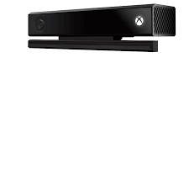
Database
Patient
Patient System
Doctor System
Kinect
Notes:
Deeksha

Slide 9
System Overview
CardioHealth is a home-based rehabilitation system for patients in rehabilitation of cardiovascular diseases with a user-friendly interface and also a doctor-patient interaction system for doctors/physiotherapists to diagnose and examine patients without face-to-face interaction
CardioHealth utilizes the Kinect V2, patients must perform exercises in front of the Kinect and results are sent straight to the patient's Doctor/Physiotherapist
CardioHealth uses heart rate estimation to determine the patient’s heart rate through exercises
Notes:
Deeksha

Slide 10

Patient 1 exercises
Exercise Record 1
Feedback / Comment
Prescribes Exercise
CardioHealth System
Exercise Record 2
Patient 2 exercises
View all patient records
Patient 3 exercises
Exercise Record 3
Doctor System
Patient System
Notes:
Deeksha

Slide 11
Kinect
CardioHealth System
Exercises
Records
Feedback
MongoDB - database
Store the exercises to be prescribed
Records of exercises
Unity - 3D model and virtual space
Visual Studio - IDE
Kinect SDK - skeletal tracking API
Website - front end
ASP.net - programming language for patient view, doctor view and general website
Microsoft Azure - to store database and front end
Notes:
Prathibha

Slide 12
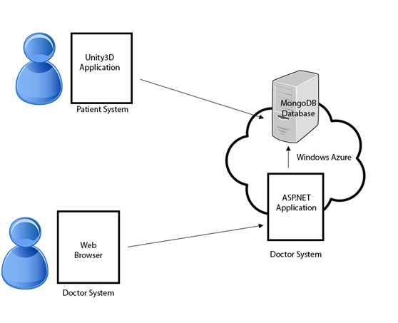
System Architecture diagram

Slide 13
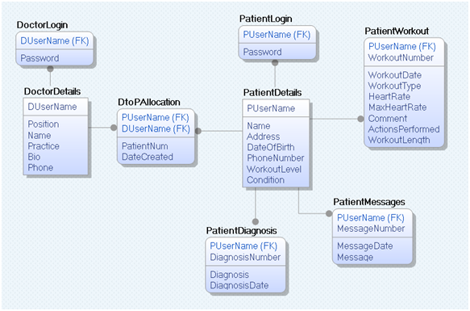
Database

Slide 14
EXPECTED OUTCOMES
To establish a customized plan to help the patient to regain strength
To prevent the condition from worsening and reduce the risk of future heart problems
To get regular feedback and updates on the exercises
To improve the patient health and quality of life

Slide 15
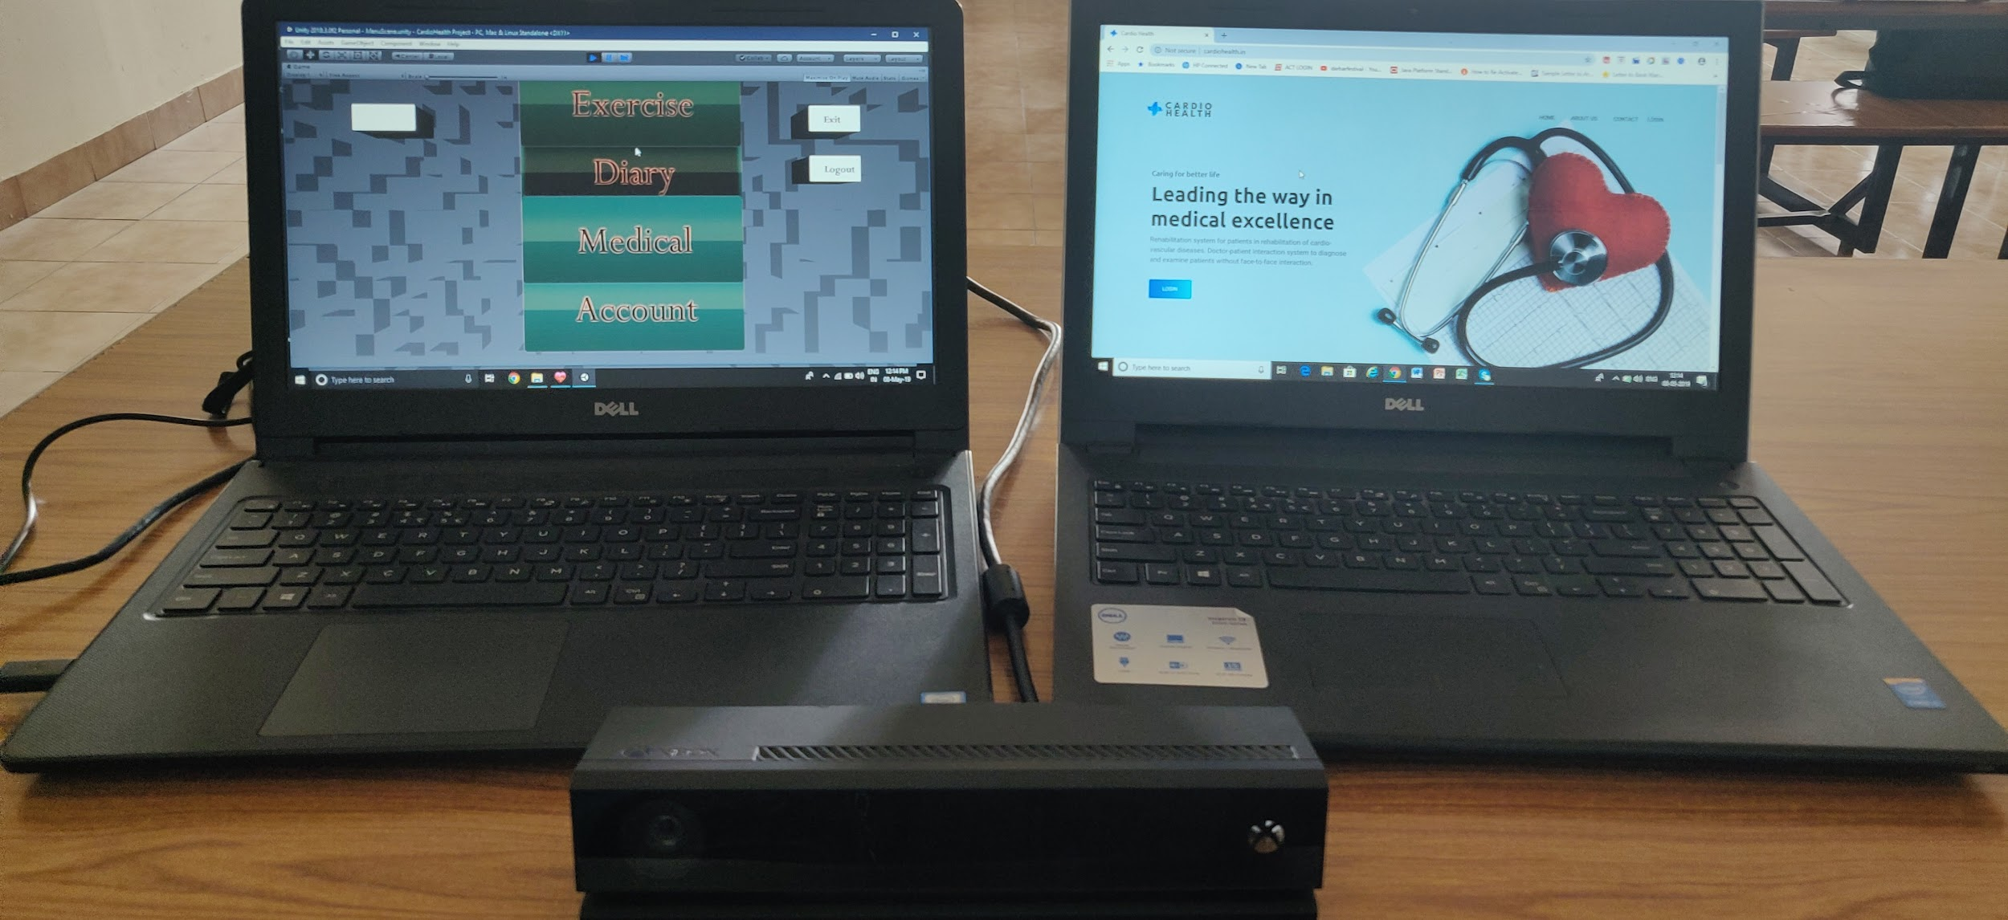

Slide 16
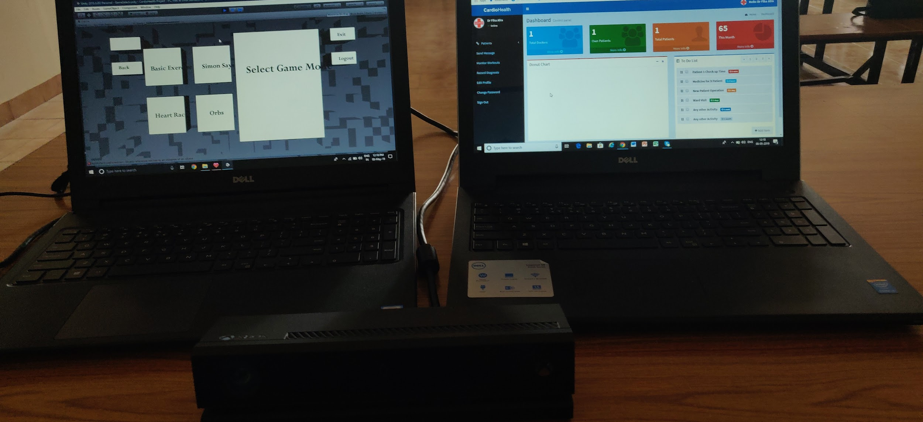

Slide 17
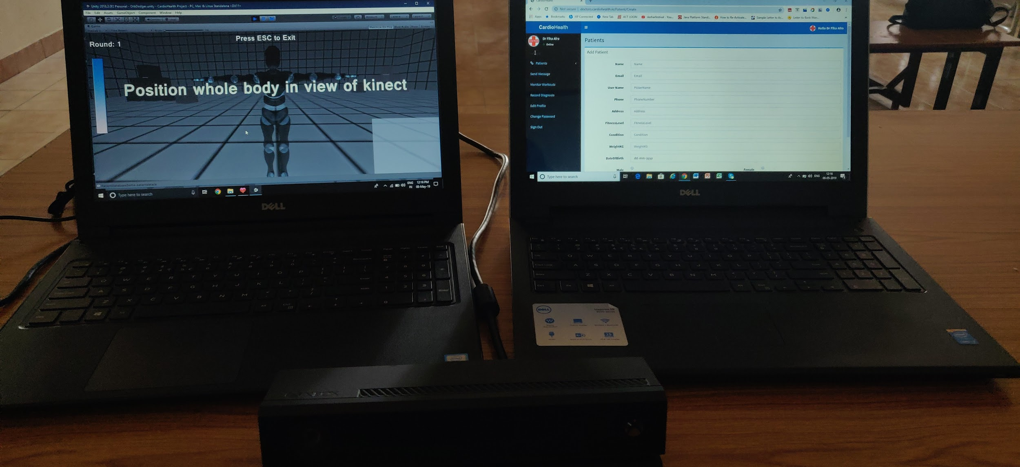

Slide 18


